Slide 1
ThingWorx Composer a web-based modeling & development environment
IoT Lecture Series
Prof. John Lee
IUPUI & KAIST

Slide 2
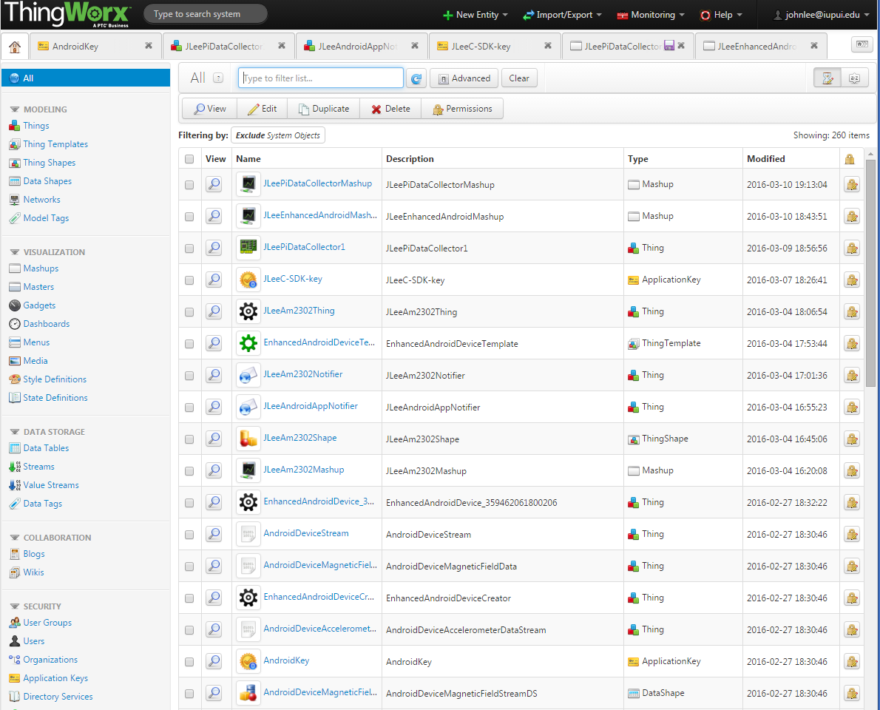
Composer Home View

Slide 3
GUI Composer 구성 요소들
Base Thing Template
Thing Template and Thing
Thing Shape
Value Stream or Data Stream
Event Notifier
Mashup (i.e., GUI or webpage) builder
AppKey
MailServer
Various SDKs
C-SDK
Java-SDK
Many extensions for various services, protocols, and devices
ThingWorx Marketplace (http://marketplace.thingworx.com/)
http://support.ptc.com/cs/help/thingworx_hc/thingworx_6.0_hc/

Slide 4
Terms
The Composer
A web-based modeling and development environment
Thing (real)
a device, physical asset, system or business process
connected to the Internet
An example: a portable weather station….
In the Composer, a Thing is a data model (abstract) of a real thing.
Something that takes in data and uses it to fire events, process services, etc. within the rest of the system based

Slide 5
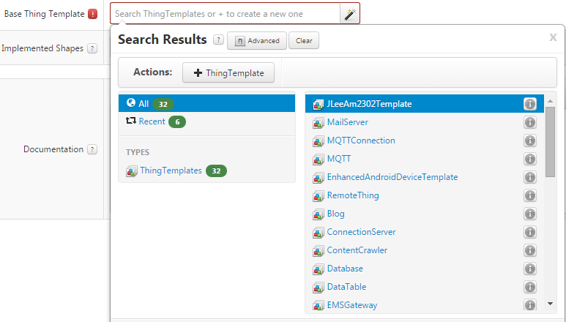
Base Thing Templates (page 1/3)

Slide 6
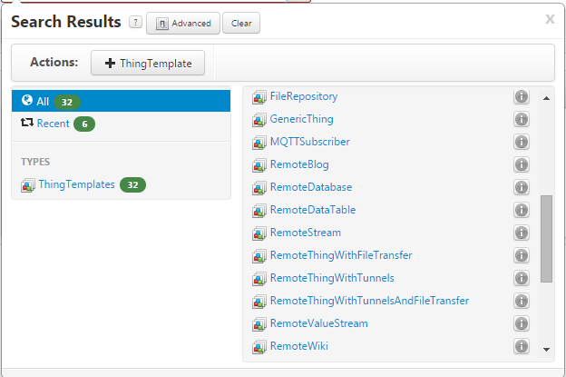
Base Thing Templates (page 2/3)

Slide 7
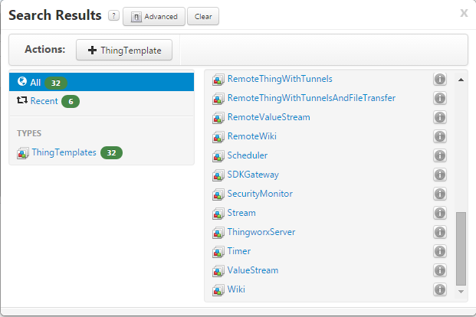
Base Thing Templates (page 3/3)

Slide 8
Terms
Edge Micro Server (EMS)
A device embeddable service (client code) providing a real time data channel to the ThingWorx server
Available in C, Objective C, Java, and .NET versions
MashUps
Web pages constructed with the Widgets that know how to connect with data on the ThingWorx server
Streams
Fast data storage used to capture the Properties of your Things as they change over time.

Slide 9
Terms
Tag
A way for ThingWorx to identify (label) different elements (i.e. Thing Shapes, Things, etc.) as being part of the same project, which allows you to transfer projects across different servers

Slide 10
Terms
Thing Shape
Building blocks that can either go and build a template and then build a thing,
or that can directly help you to build a thing
tied to a project (tag)

Slide 11
Terms
Thing Templates
Like base classes in an object oriented language
A way to combine shapes (multiple sources of data) that allows you to add additional property services, subscriptions, and events to create a unique template that allows for the rapid creation of any new thing
tied to a project (tag)
created based on a Base Thing Template
e.g., RemoteThing (for receiving data remotely)
may need Thing Shape
may need Value Stream

Slide 12
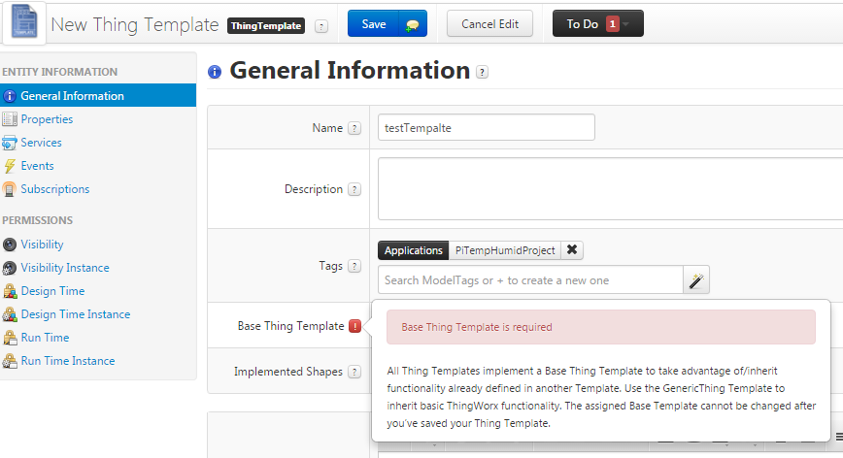
Creating a new Thing Template

Slide 13
Additional Terms
Value Stream
Properties
Services
Events
Subscriptions

Slide 14
Project Building Steps
Make your device and code its EMS details
can use C-SDK, Java-SDK, etc.
Create an app-key
May creare ProjectName (an application name based on app-key): used as a tag
only used for linking of things in one project
Create your Thing
Base-Template ➔ Thing Template ➔ Thing
Many Base-Templates are provided
Thing Shapes

Slide 15
Part of Device Source Code (EMS)
@ThingworxPropertyDefinitions(
properties = {
@ThingworxPropertyDefinition(
name = "Prop_Humidity",
description = "A Current humidity value from a AM2302 sensor.",
baseType = "NUMBER",
aspects = {
"dataChangeType:ALWAYS",
"dataChangeThreshold:0",
"cacheTime:0",
"isPersistent:FALSE",
"isReadOnly:TRUE",
"pushType:VALUE",
"defaultValue:0"
}
),
@ThingworxPropertyDefinition(
name = "Prop_Temperature",
description = "A Current temperature and humidity value from a DHT22 sensor.",
baseType = "NUMBER",
aspects = {
"dataChangeType:ALWAYS",
"dataChangeThreshold:0",
"cacheTime:0",
"isPersistent:FALSE",
"isReadOnly:TRUE",
"pushType:VALUE",
"defaultValue:0"
}
),
}
)

Slide 16
Creating a Thing
Create based on a Thing Template
If you don’t have (or don’t need) your own Thing Template, you can use GenericThing Template
Tied to a project (tag)
Users may want to create both a Thing Shape and a Thing Template that will define and house the Thing.
Notes:
This will allow you to later utilize the data in a Mashup.

Slide 17
Binding Data between a model Thing and real Thing
Need to create properties
Names of properties must match with your sensor’s property names that you used when you implement your device
Created within a Thing Shape or Thing Template
Property types can be numbers, strings, Boolean, etc.
Can also create alerts
E.g., Humidity is higher than 60%

Slide 18
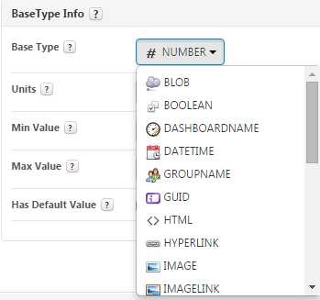
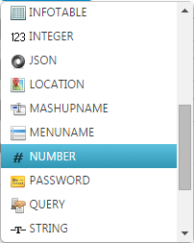
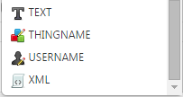
Property Base Types

Slide 19
Binding Data with a Thing
Within a Thing
Bind the created properties with the data source (EMS side)
At this moment in order for the ThingWorx to know data source with property names, the device should have already been connected to the server.
So, there should be a Monitoring window in the Composer
displays connection status of devices
see next slide

Slide 20
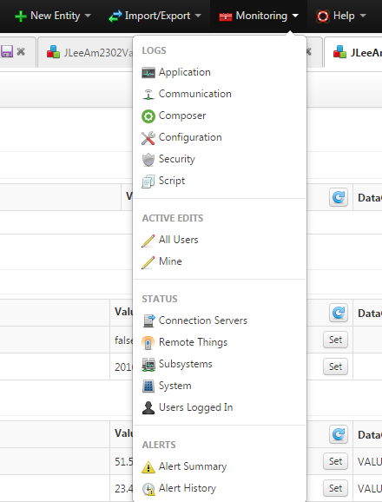
Monitoring Window

Slide 21
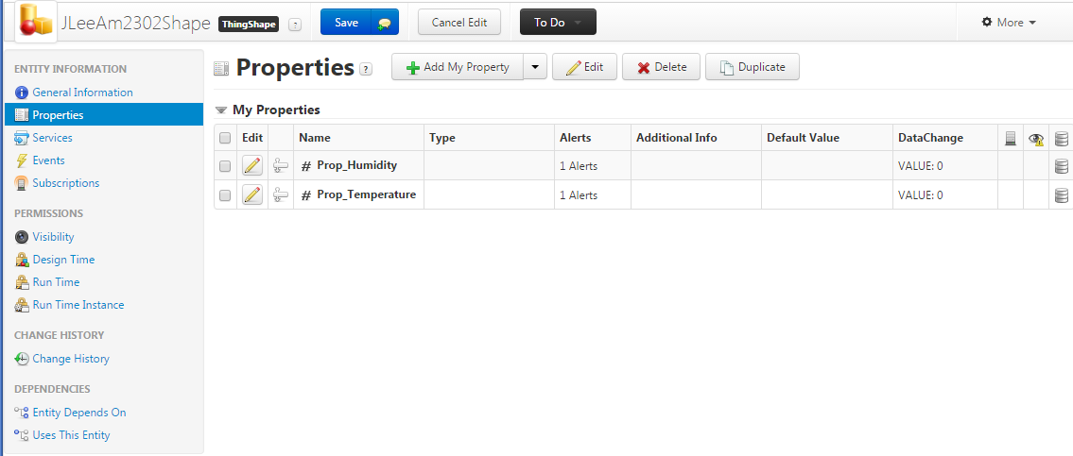
Thing Shape—Properties

Slide 22
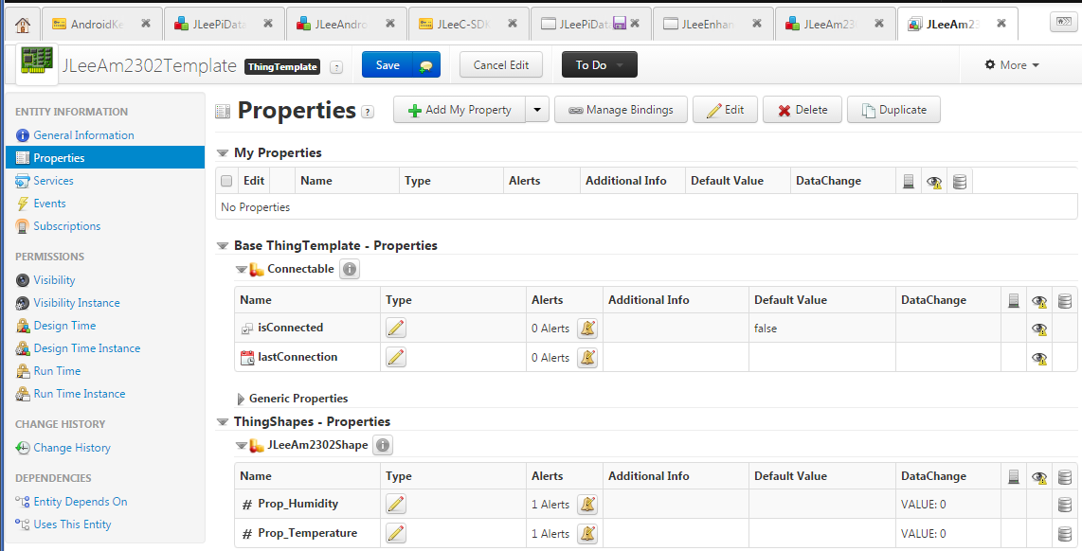
Thing Template—Properties
Modify alert

Slide 23
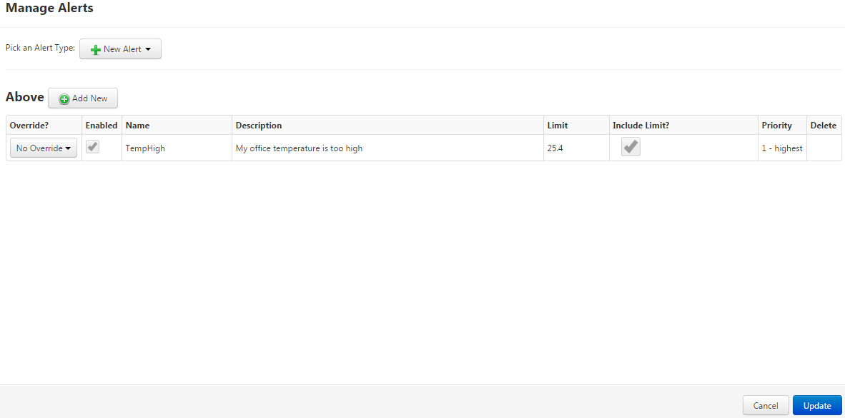
Thing Template—Properties—Alert

Slide 24
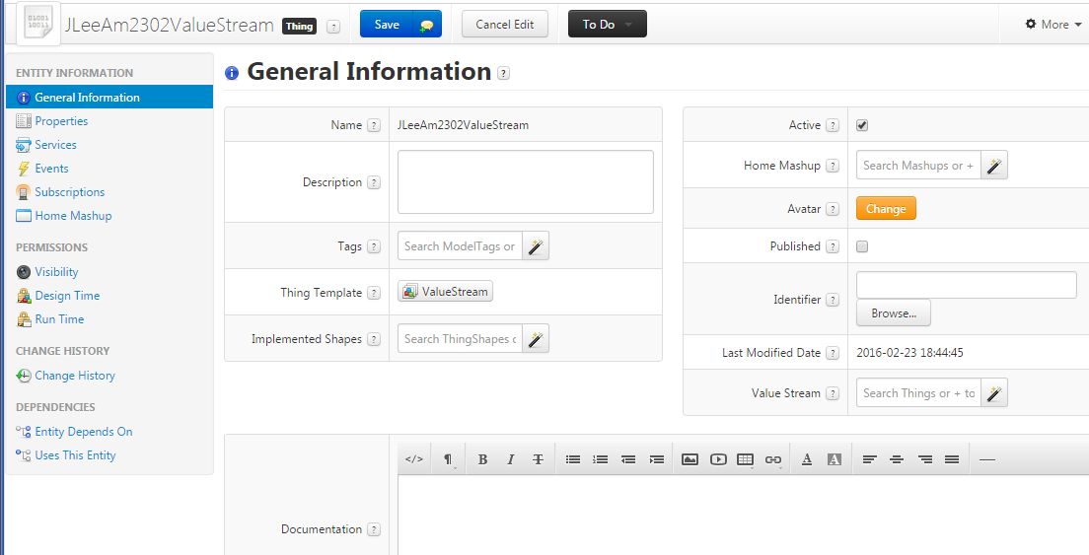
Value Stream (for sensor data streaming)

Slide 25
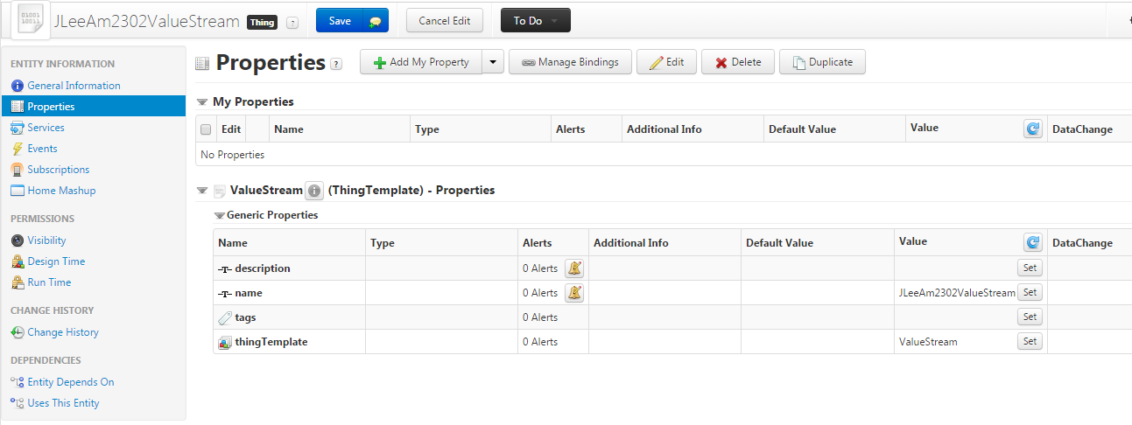
Value Stream—Properties

Slide 26
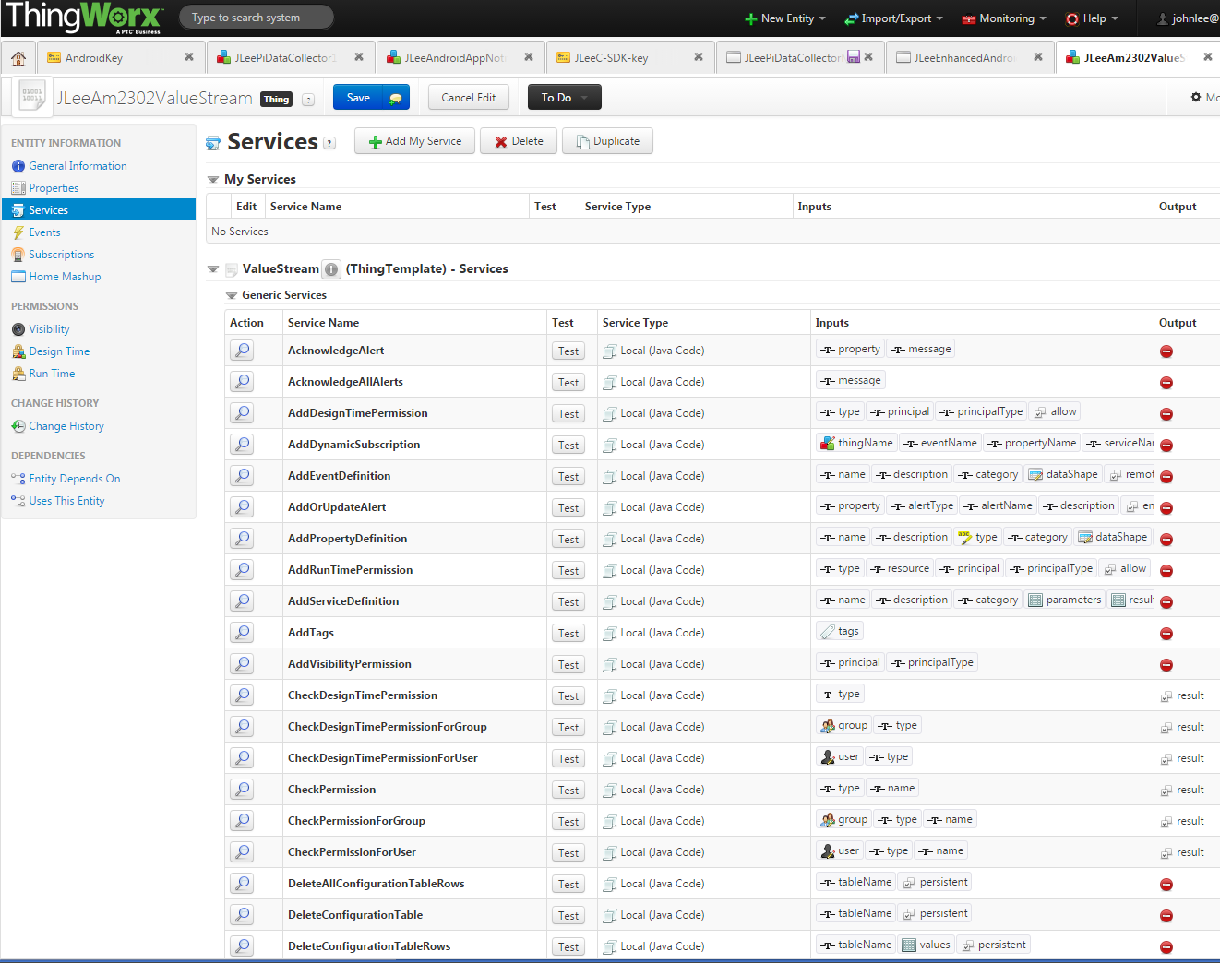

Slide 27
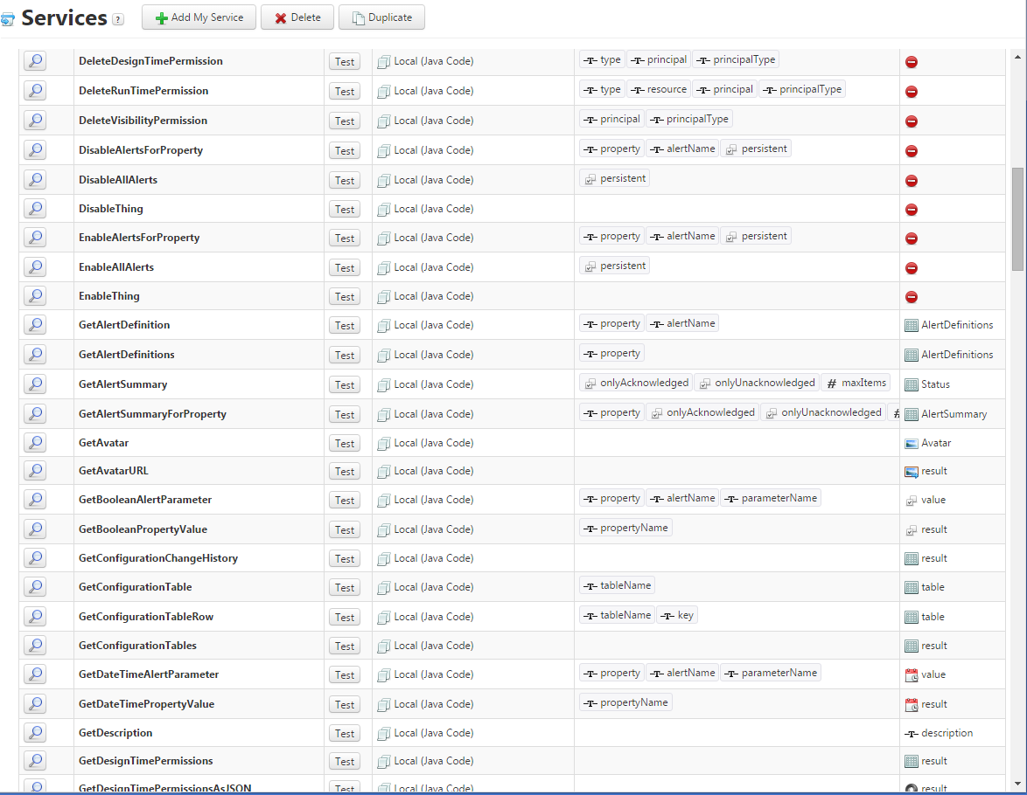

Slide 28
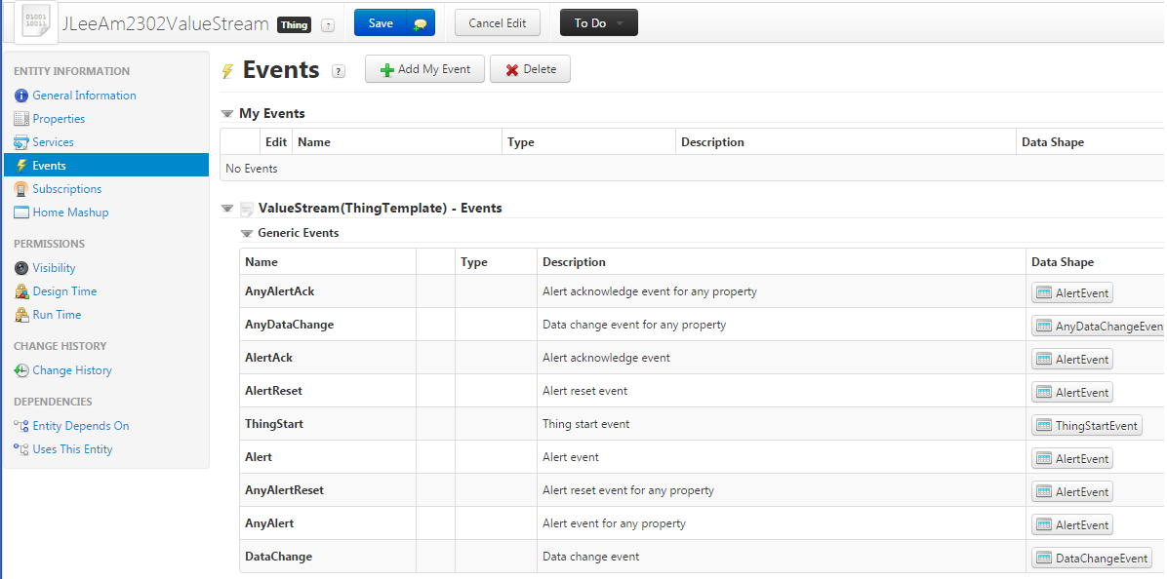
Value Stream—Events

Slide 29
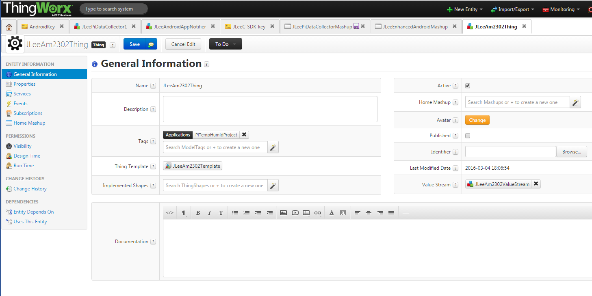
Thing—General Information

Slide 30
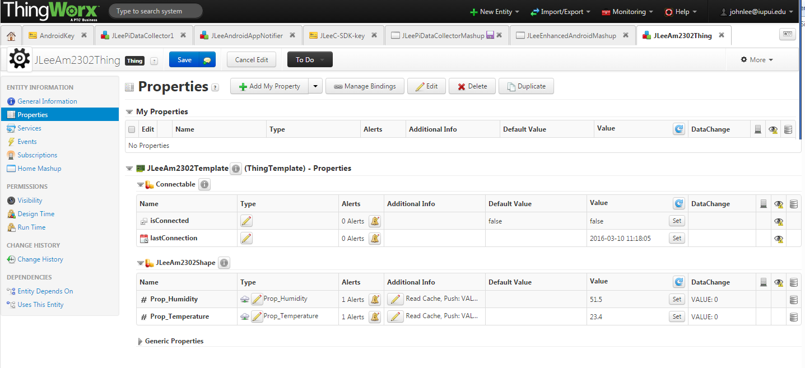
Thing—Properties

Slide 31
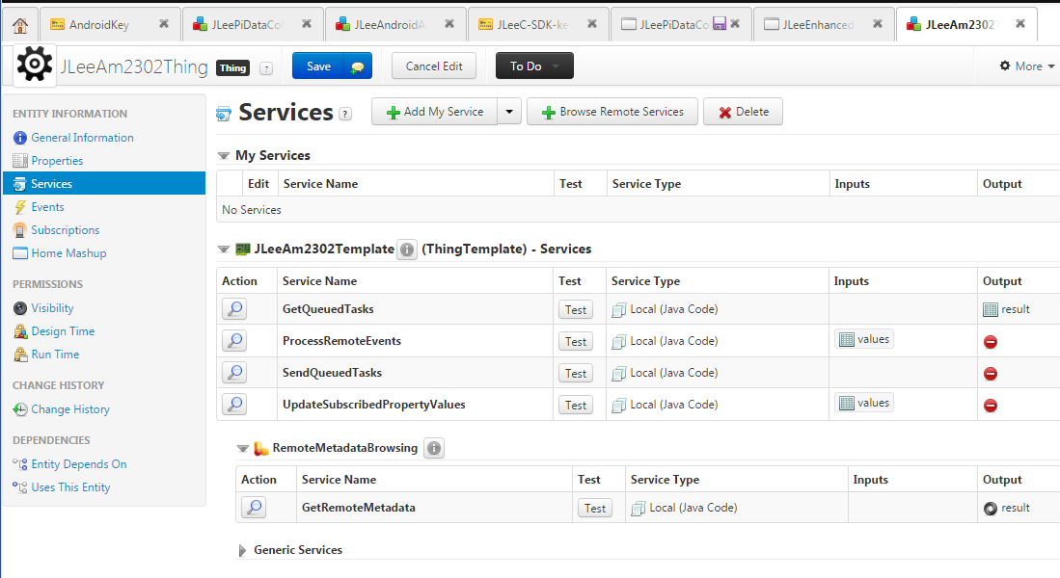
Thing—Services

Slide 32
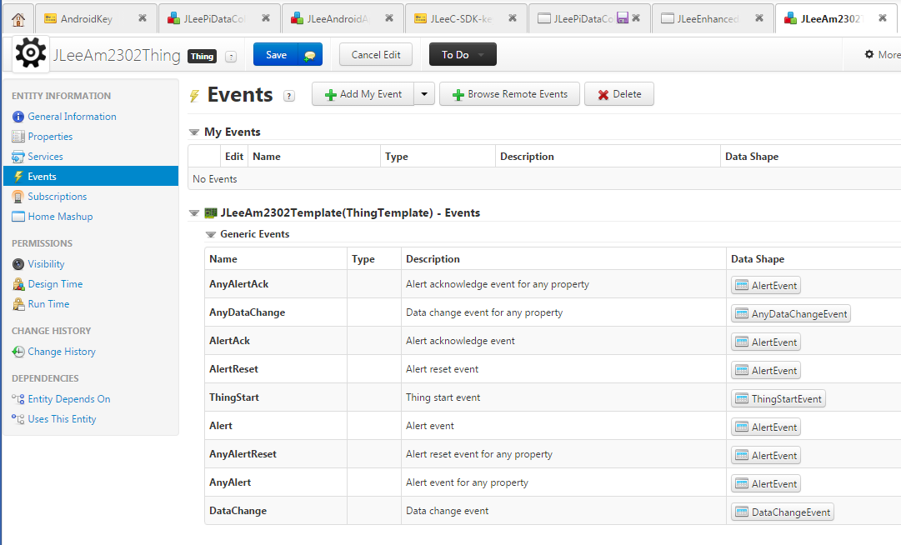
Thing—Events

Slide 33
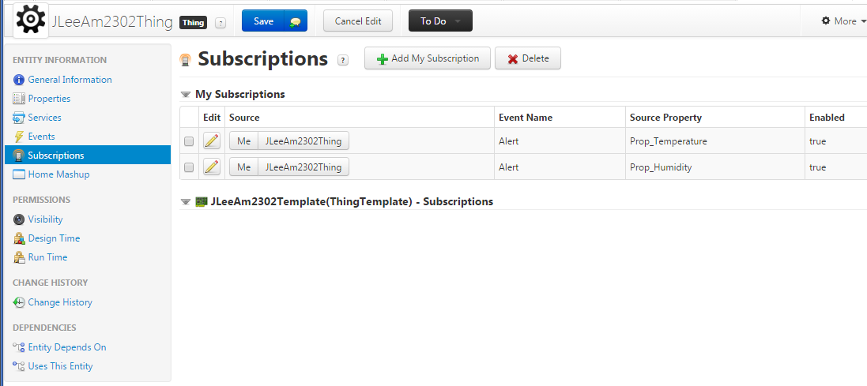
Thing—Subscriptions for events
Used to raise an alert while monitoring sensor data

Slide 34
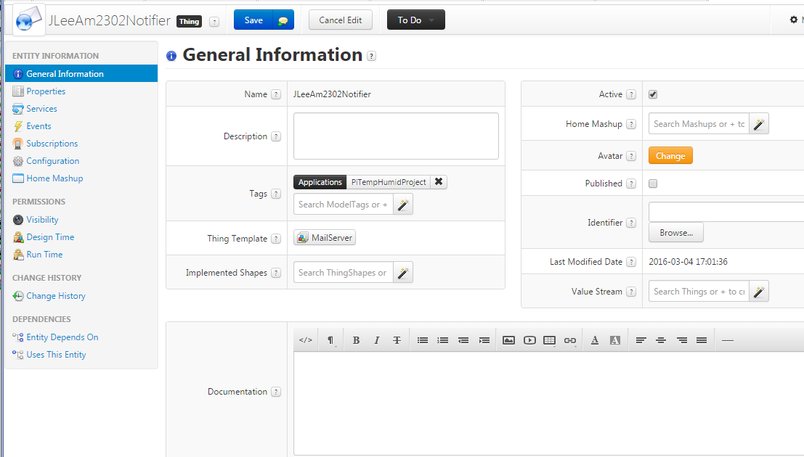
Event Notifier
Describe what to do for chosen events

Slide 35
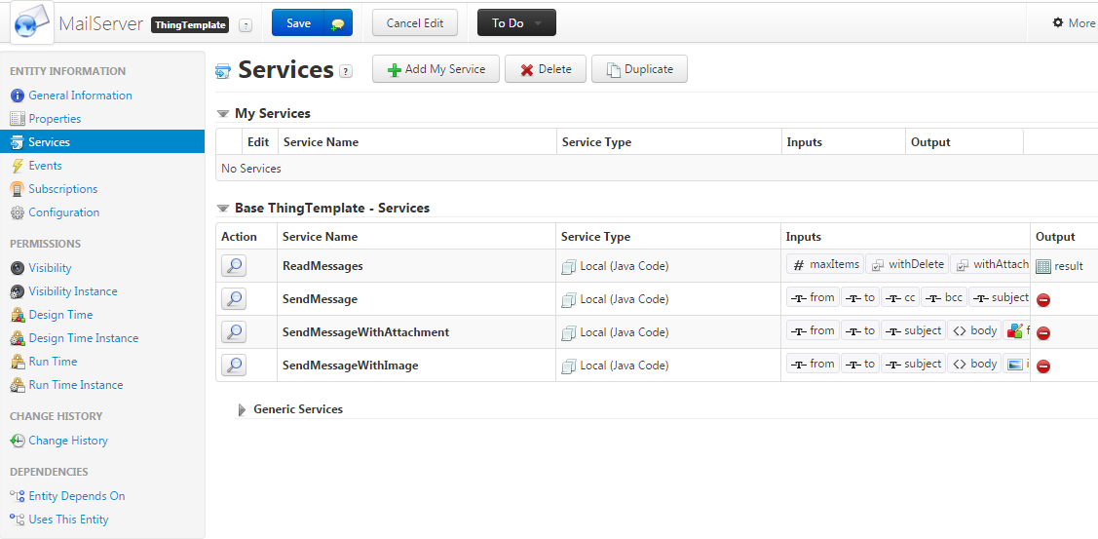
MailServer—Services
Can be used to send an email upon some events

Slide 36
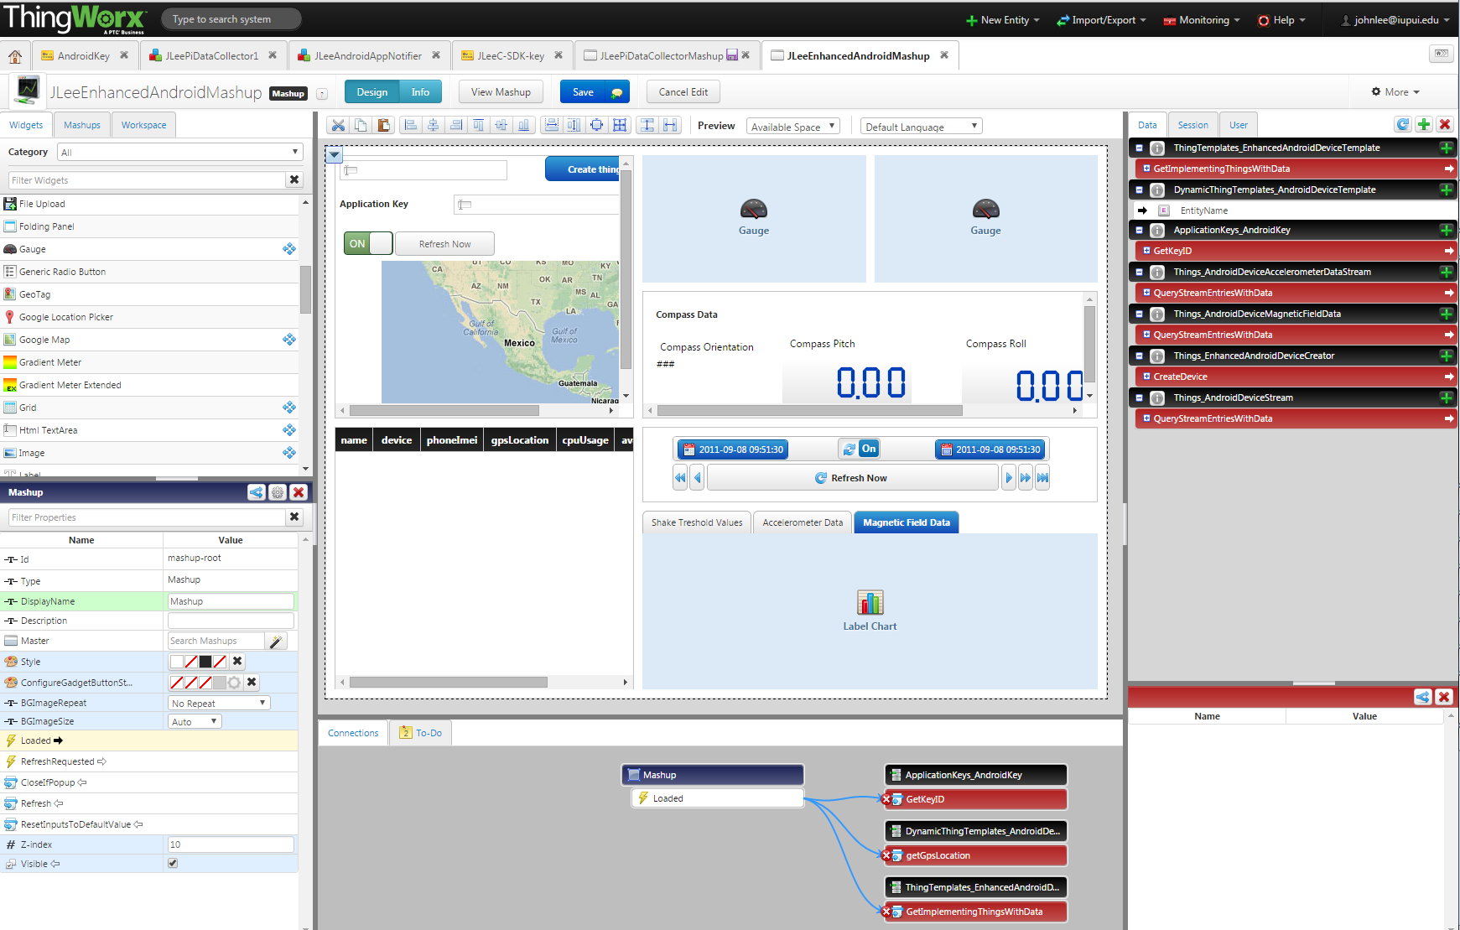
Mashup (Web Interface) Builder

Slide 37
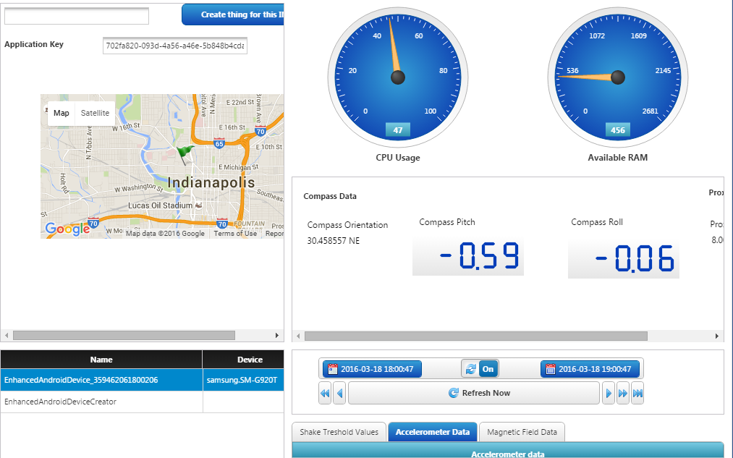
Web Interface (deployed)

Slide 38
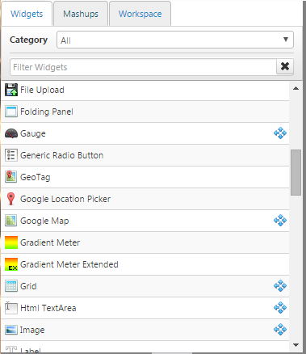
Various Widgets for Building Mashups (1/4)

Slide 39
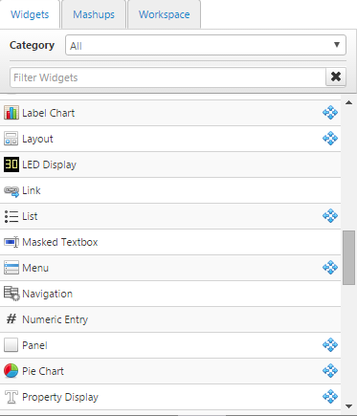
Various Widgets for Building Mashups (2/4)

Slide 40
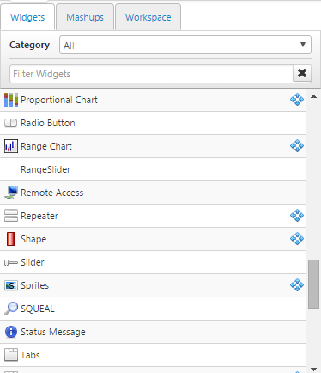
Various Widgets for Building Mashups (3/4)

Slide 41
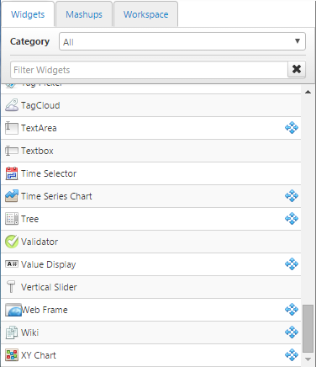
Various Widgets for Building Mashups (4/4)

Slide 42
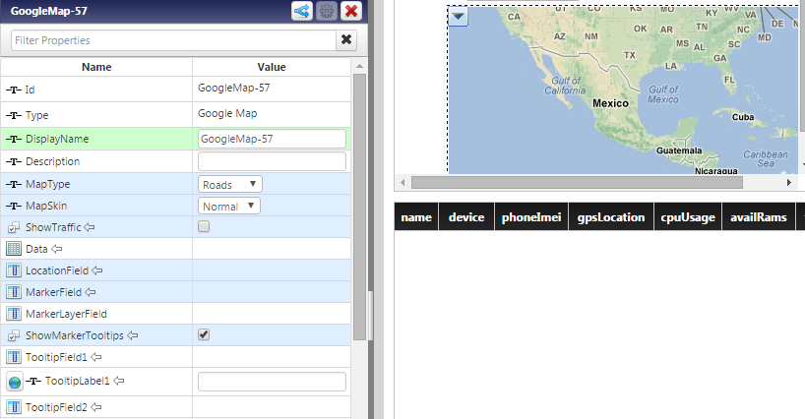
Configurable Properties of Google Map Widget

Slide 43
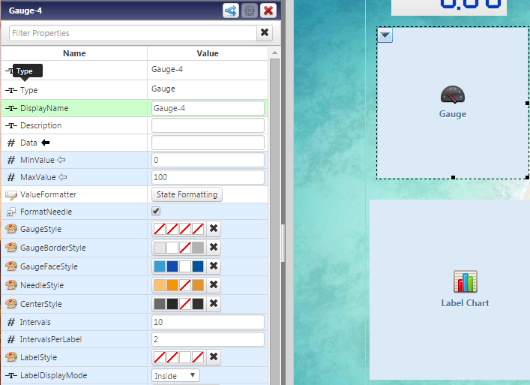
Configurable Properties of Gauge Widget

